Slide 1
Stock Price Prediction System
Group – 10
Section – B1
Rolls: 1505076
1505080
1505089

Slide 2
Data Flow Diagram : Predictor Sub-system

Slide 3
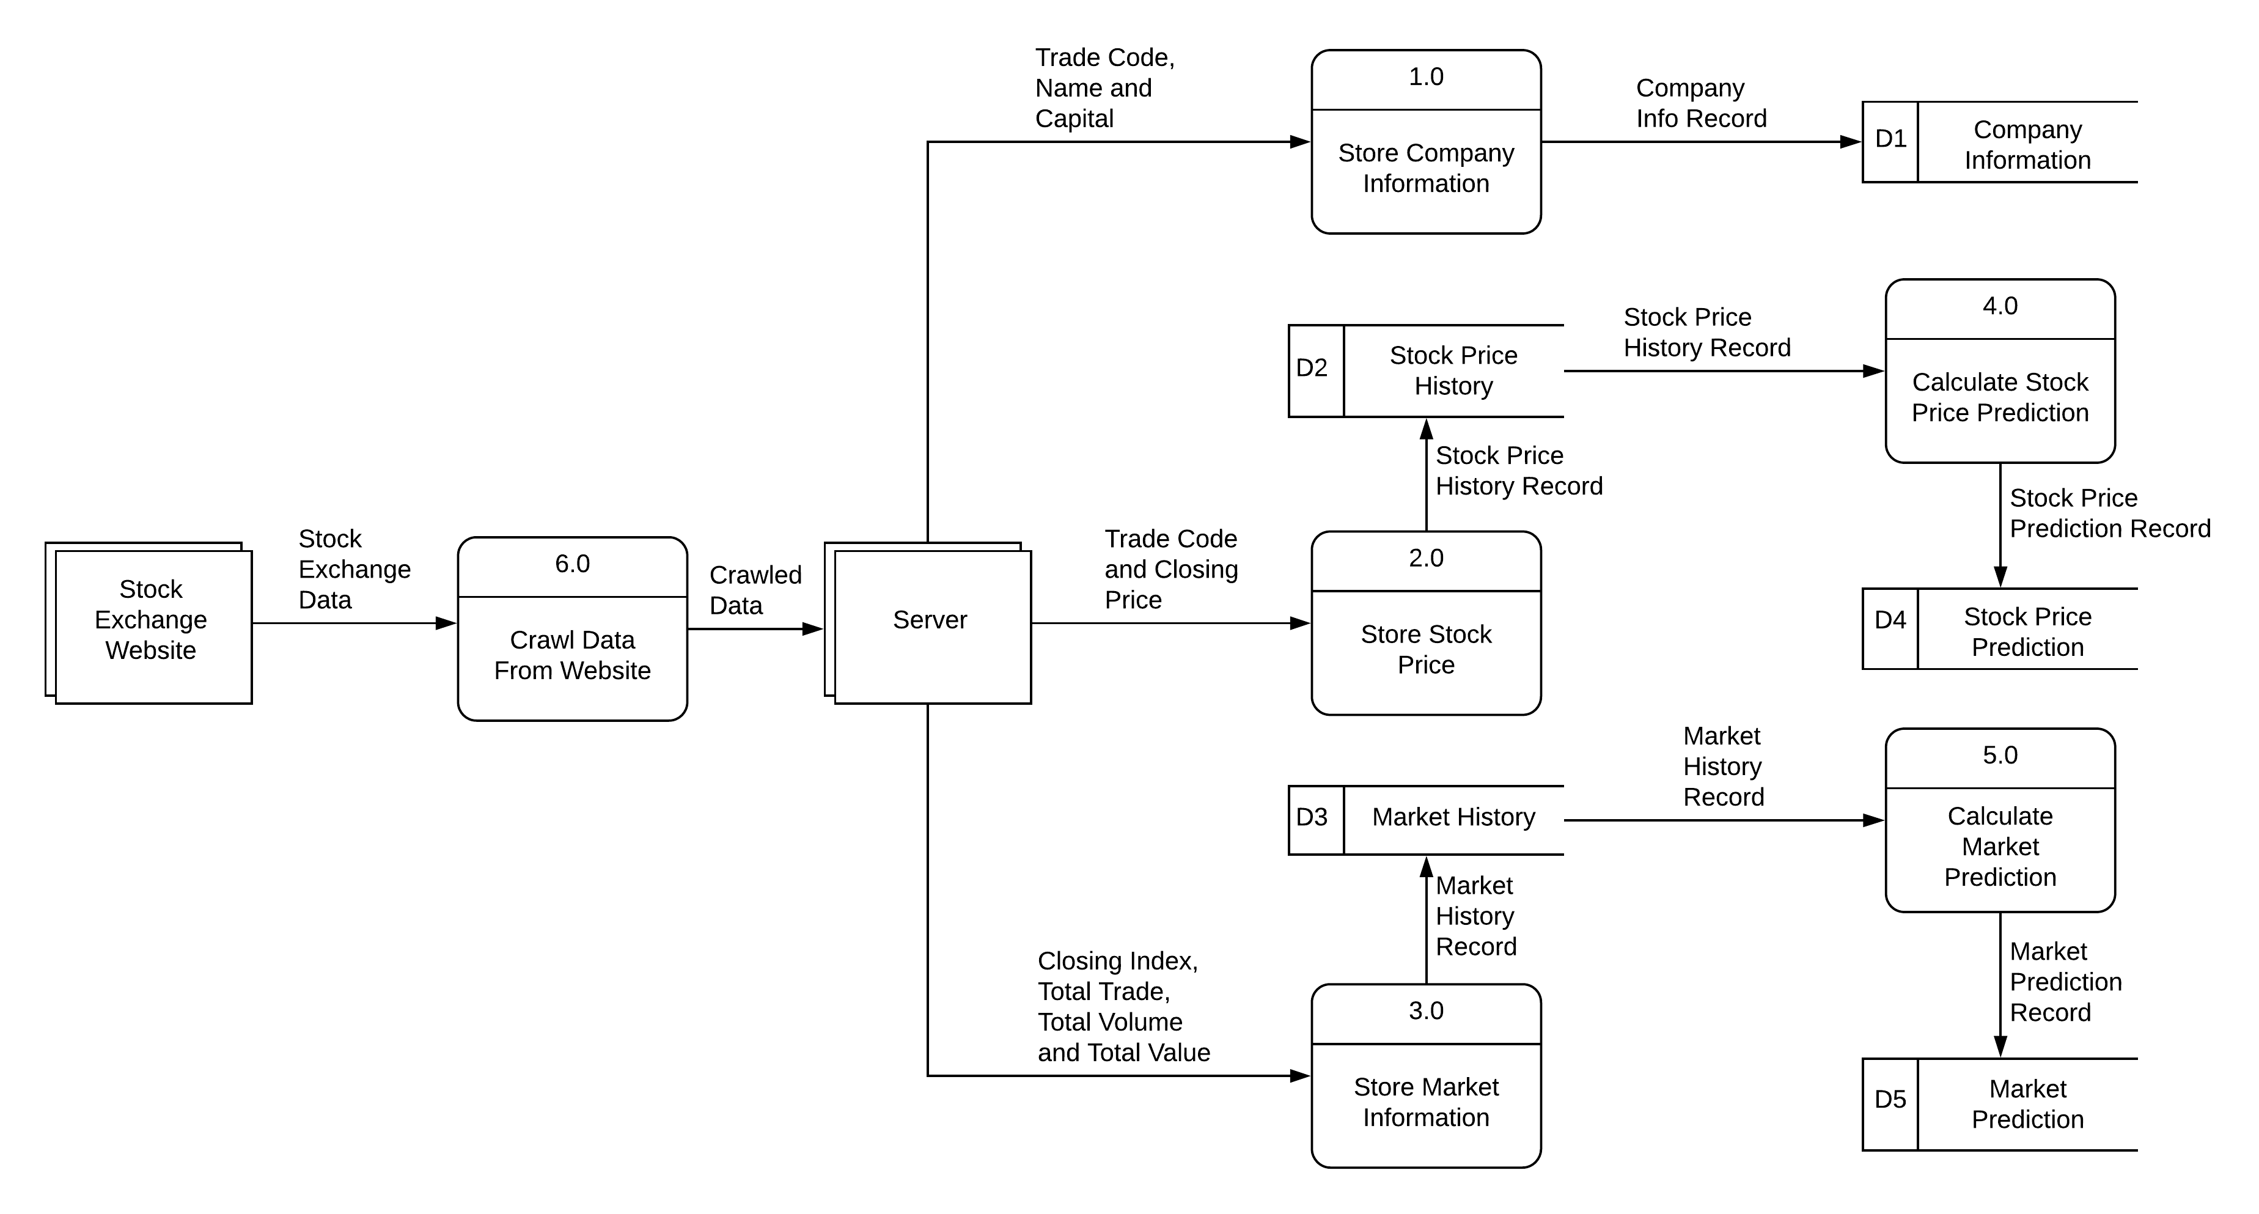

Slide 4
Data Flow Diagram : Viewer Sub-system

Slide 5
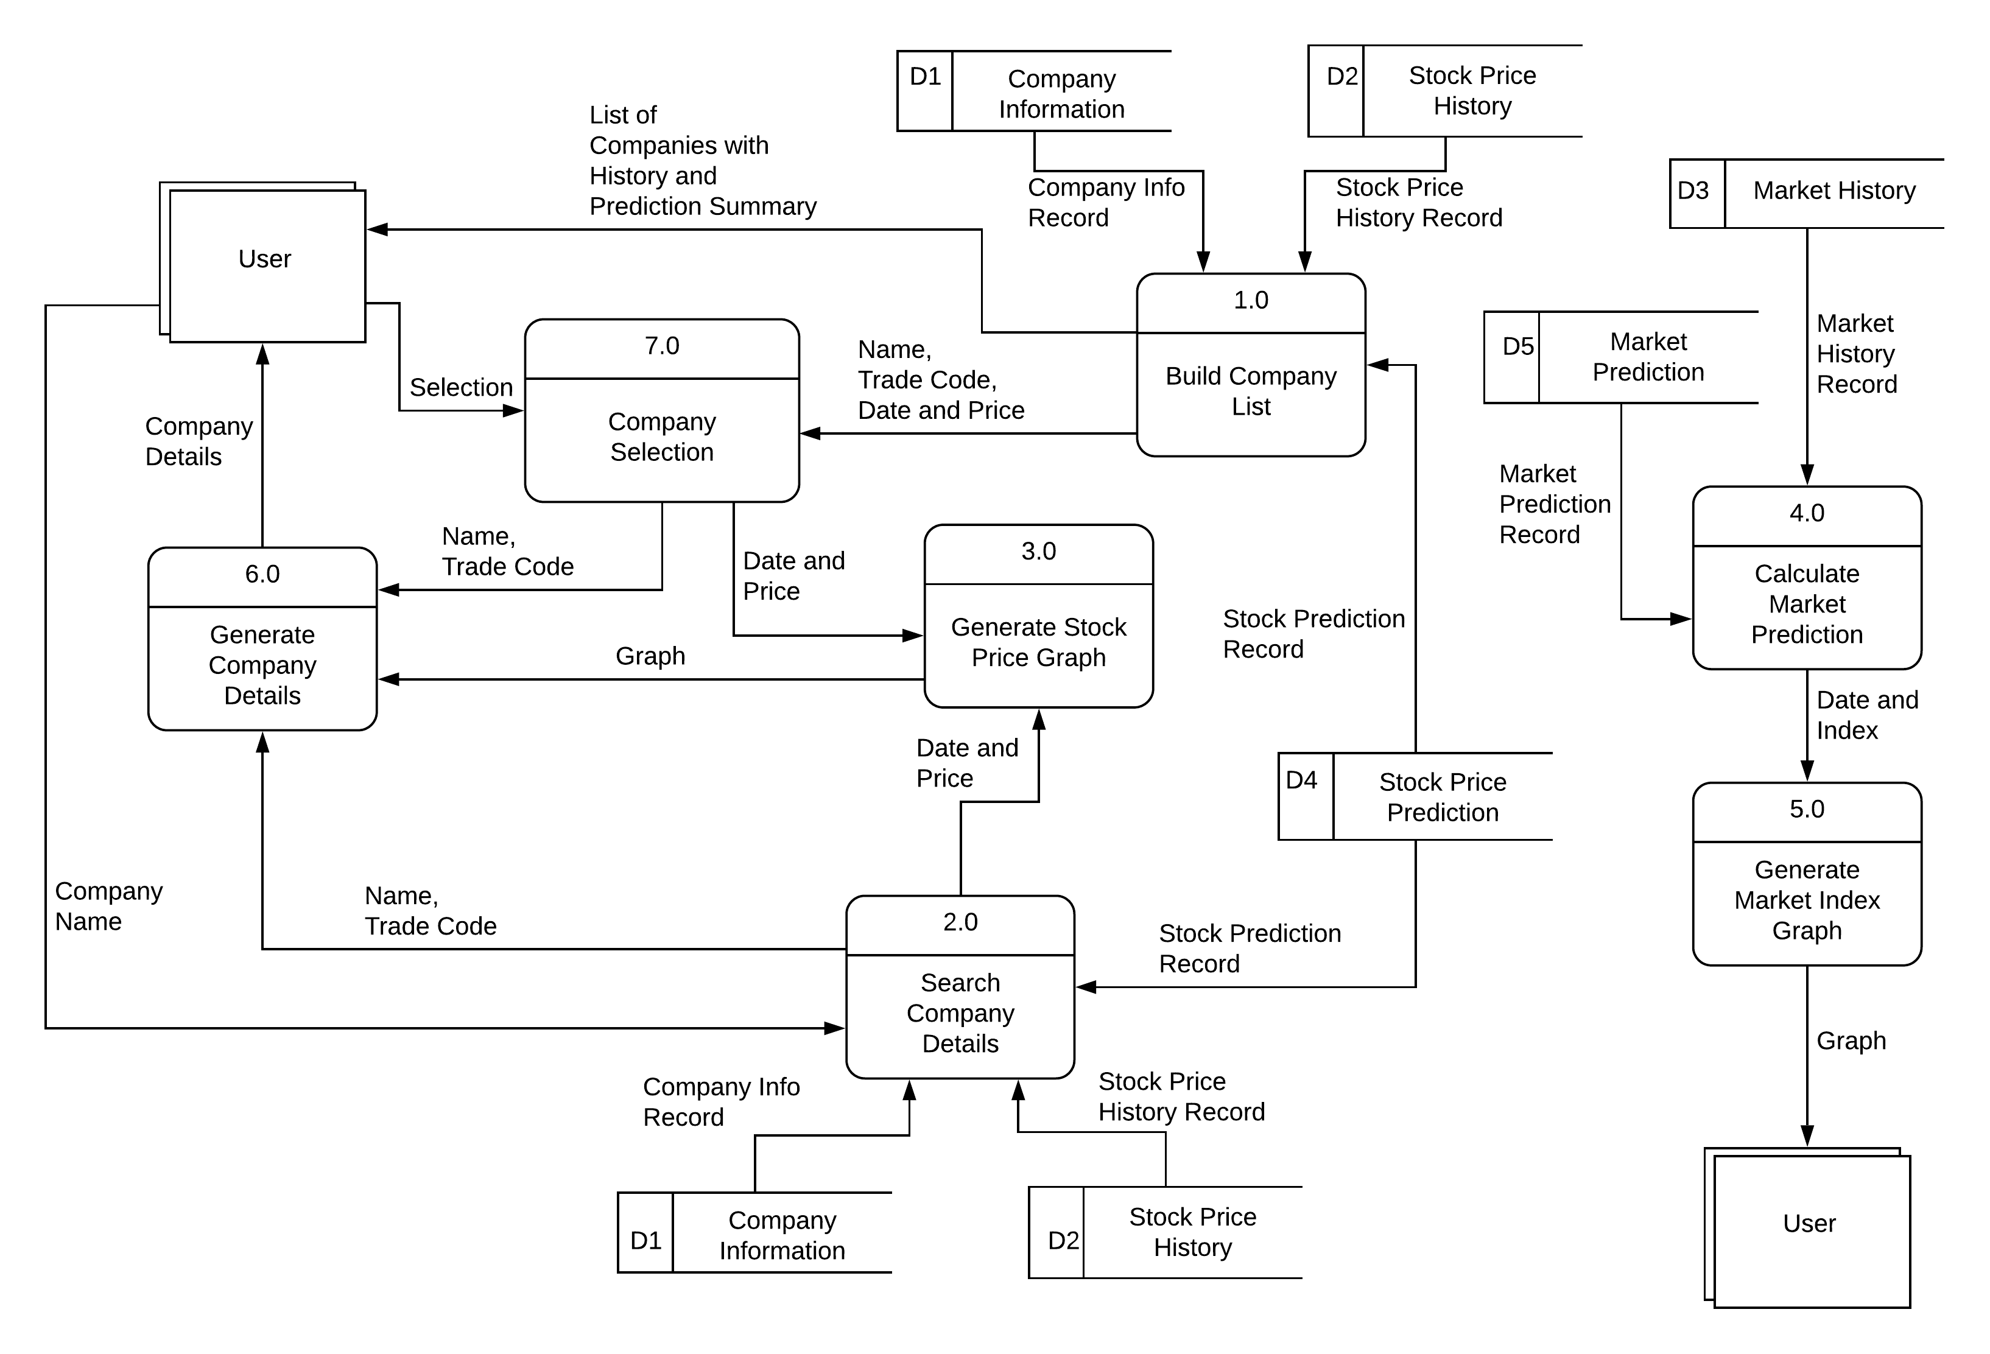
Predictor Sub-System

Slide 6
Sequence Diagram : Search

Slide 7
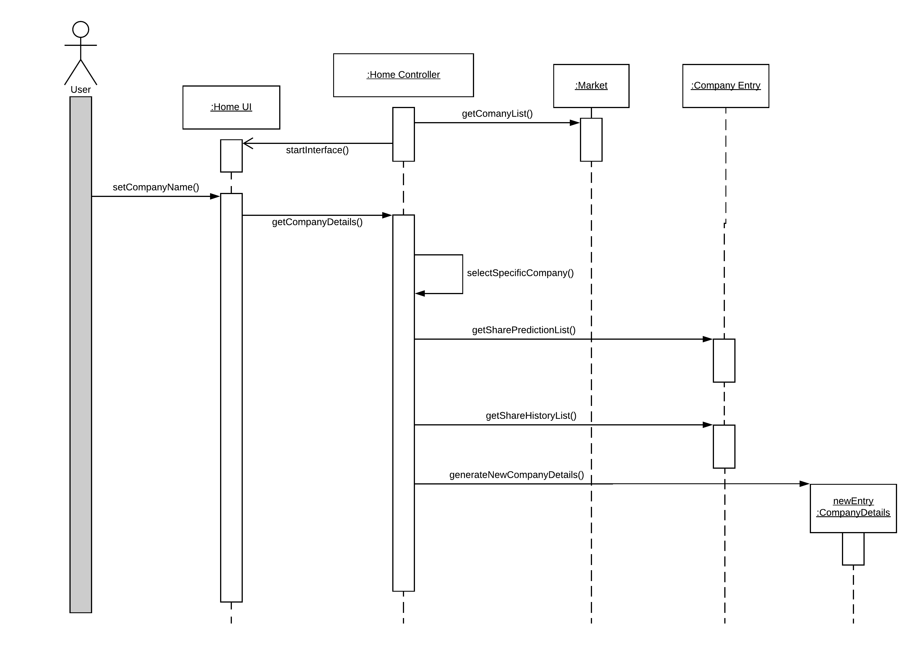
Prediction Viewer Sub-System

Slide 8
Sequence Diagram : Recommendation

Slide 9
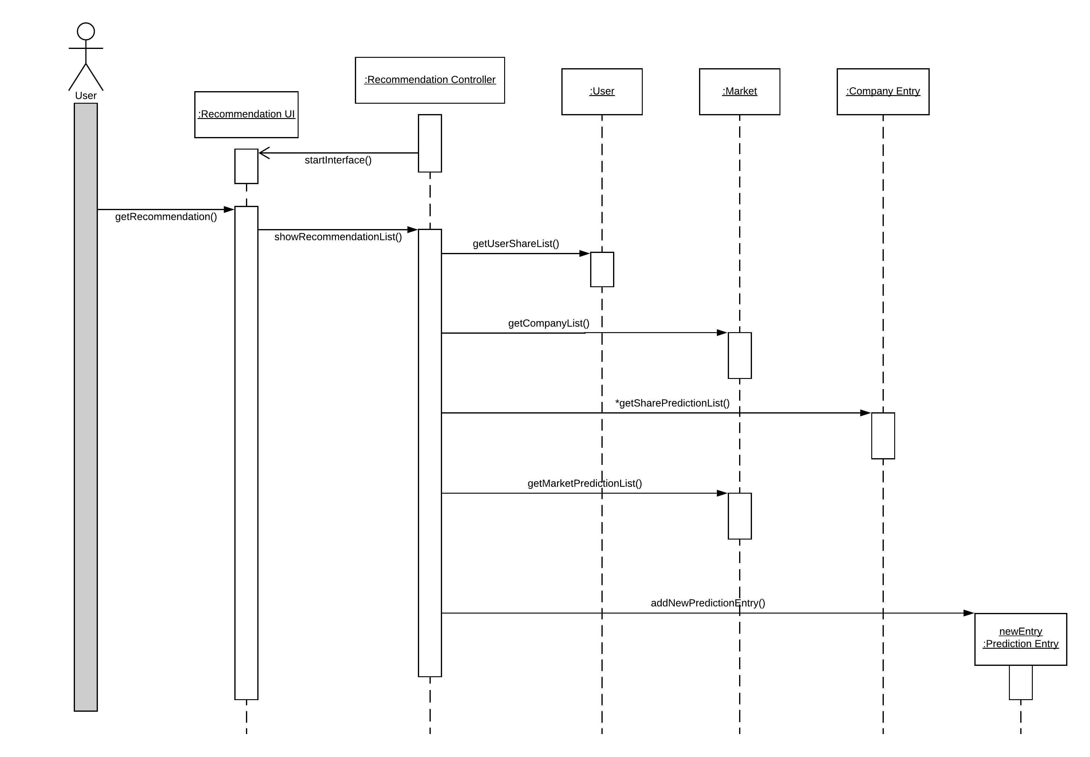
Prediction Viewer Sub-System

Slide 10
Thanks!
Any questions?

